Slide 1
802.11 Technology, Wi-Fi Basics
-Layered architecture, Modulation/coding overview

Slide 2
Contents
1.OSI 7-layer architecture
2.802.11 within OSI framework
3.Wi-Fi standards
4.Data link layer in action
5.Physical layer in action
6.802.11 Working group
7.Wi-Fi 2.4 GHz Channels
8.Wi-Fi 5 GHz channels
9. 802.11 Coding & Modulation schemes
10.DSSS coding & modulation
11. OFDM coding & modulation
12. Quadrature Amplitude Modulation

Slide 3
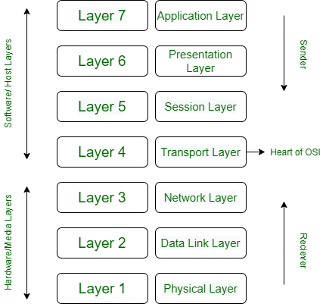

Open Systems Interconnection model (OSI) -Overview
Developed by International Standards organization in the year 1984
Basis for networking to support interoperability between different products and software.
User interaction window
Email, s/w programs
Data to common format
ASCII to EBCDIC
Translation, compression, encryption
Establish connection
& session management
authentication, authorization
data segmentation
Flow control, error control
Heart of OSI
TCP,UDP : with/without feedback
Segments encapsulated, routing packets to terminal
IP addresses on segments,
Short Path determination
Packets into Frames (Packet + MAC address of sender/Receiver
Data Frames are read & physical addresses added
Frames to bits and sent over the n/w thru a media
Data bits logically arranged, encoded before sent through a media.

Slide 4
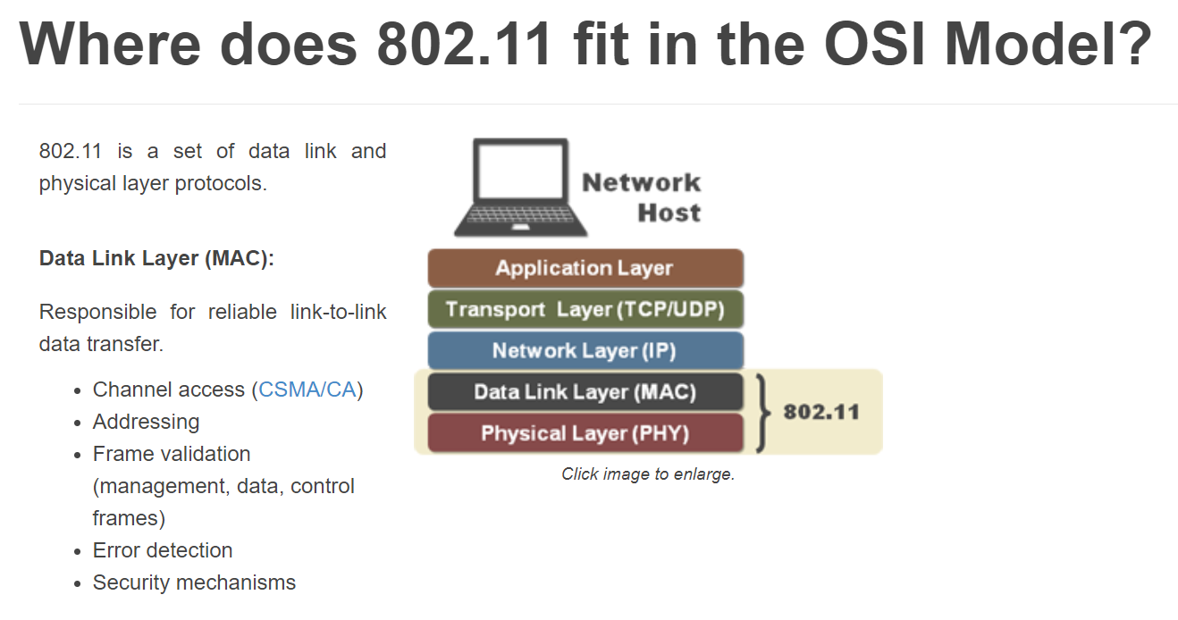
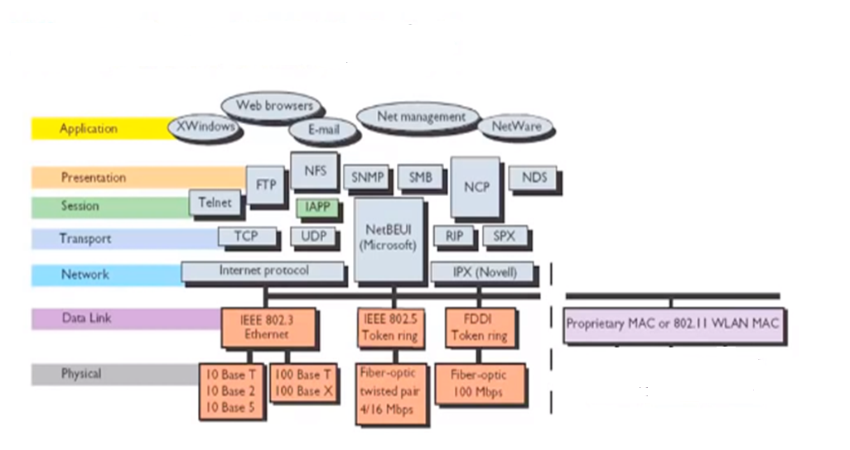
802.11 protocol within OSI framework
802.11 is a set of Data link and Physical layer protocols
Mac layer is responsible for reliable link to link data transfer (Channel access, addressing, frame validation, error detection, security mechanisms
Physical layer is responsible for data transfer through a media (Cable/Light/Wireless
2.4GHz DSSS ,OFDM
5GHz DSSS ,OFDM
6GHz DSSS ,OFDMA

Slide 5
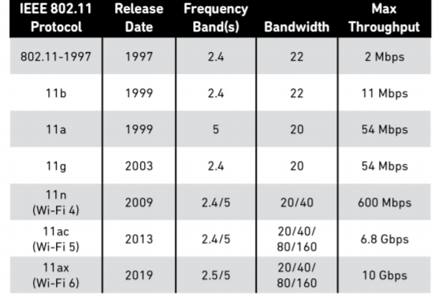
Wi Fi standards , Data link & Physical layer
Wi-Fi is a trade mark owned by Wi-Fi alliance and it is a collection of protocols that replace Ethernet cables
Data Link
Layer
Logic Link control(LLC)
Medium Access Control(MAC)
802.11
FHSS
802.11b
DSSS
802.11a
OFDM
802.11g
OFDM
802.11n
OFDM
MIMO
802.11ac
OFDM
MIMO
802.11ax
OFDMA
MUMIMO
Physical
Layer

Slide 6
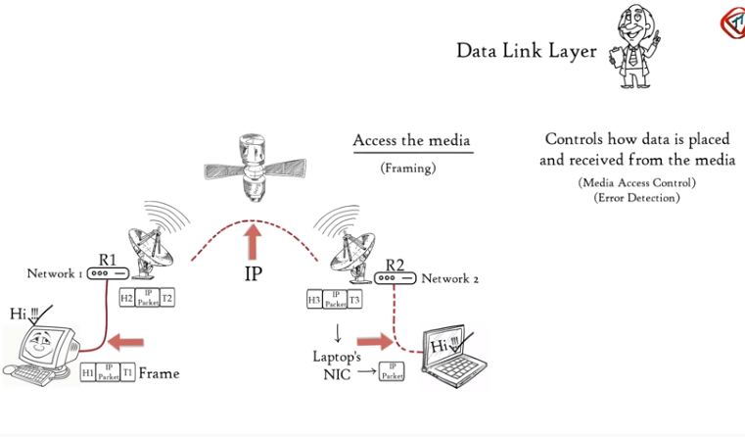
Data Link layer–Access to media and control scenario
LLC Linking upper host layers to access media (Cable/Optical/Wireless) through frames
Controls how data is placed and received from the media through Media Access Control- CSMA and Error detection ( Tail bits in the frame are for error detection)

Slide 7
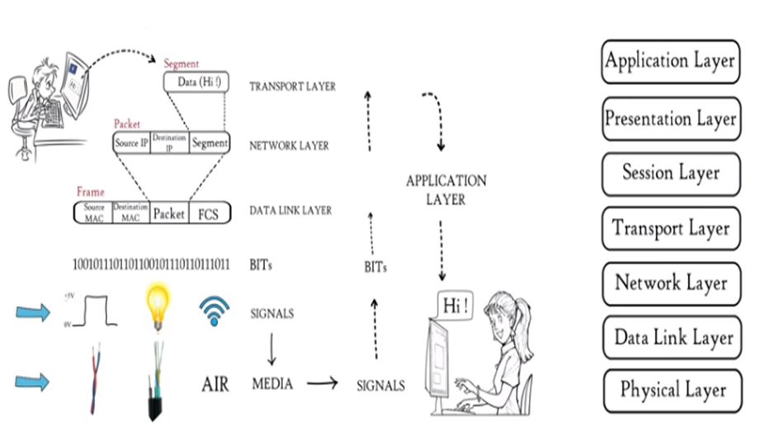
Physical layer in action – A big picture
Data frame received from DLC layer is a sequence of bits ((1’s and 0’s)
Bit sequence is converted to signal and transmit over local media (Ethernet/Fiber/Wireless)

Slide 8
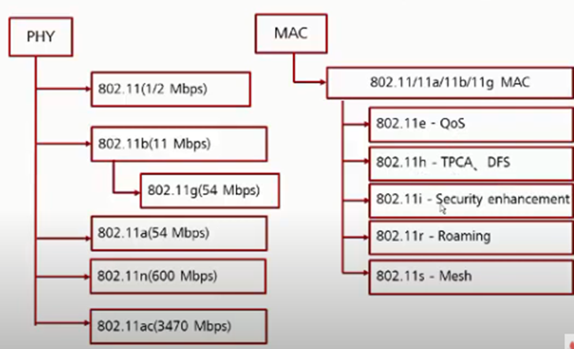
802.11 Work groups
802.11ax (9.6Gbps)

Slide 9
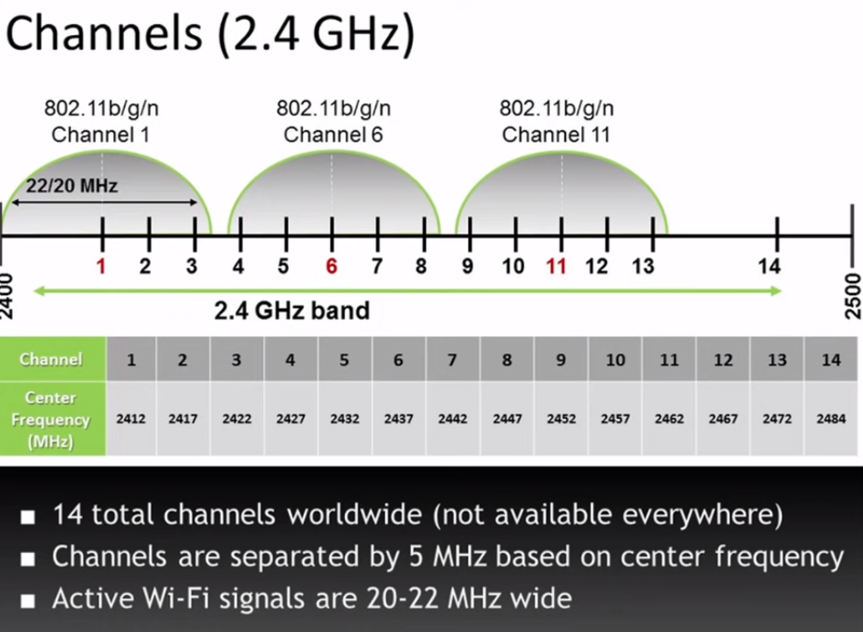
2.4GHz band Wi-Fi Channels

Slide 10
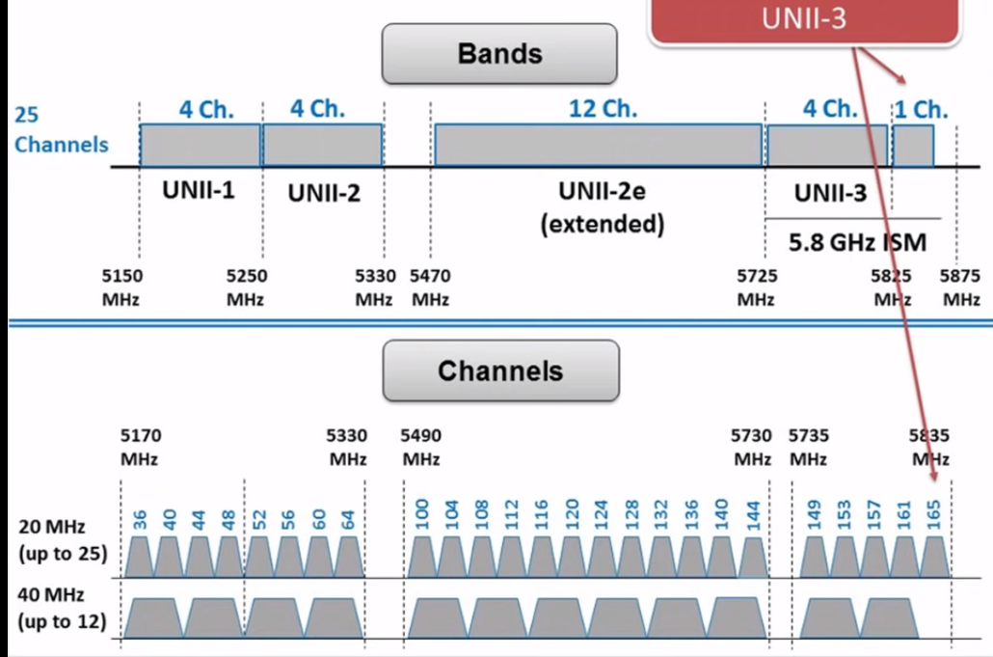
5GHz band Wi-Fi Channels

Slide 11
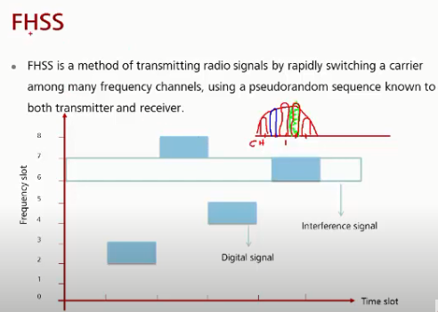
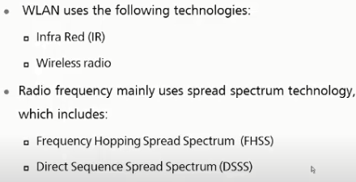
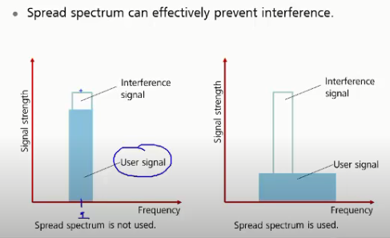
802.11 Coding &Modulation schemes
802.11 (oldest standard-1997)
Spread spectrum method

Slide 12
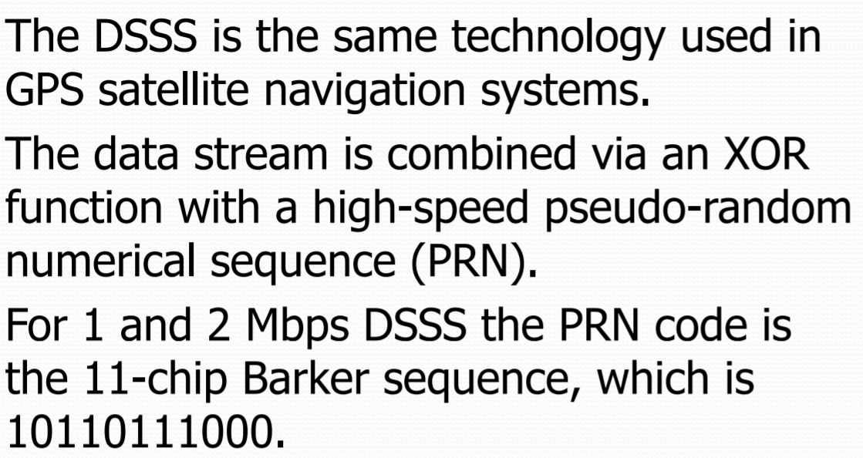
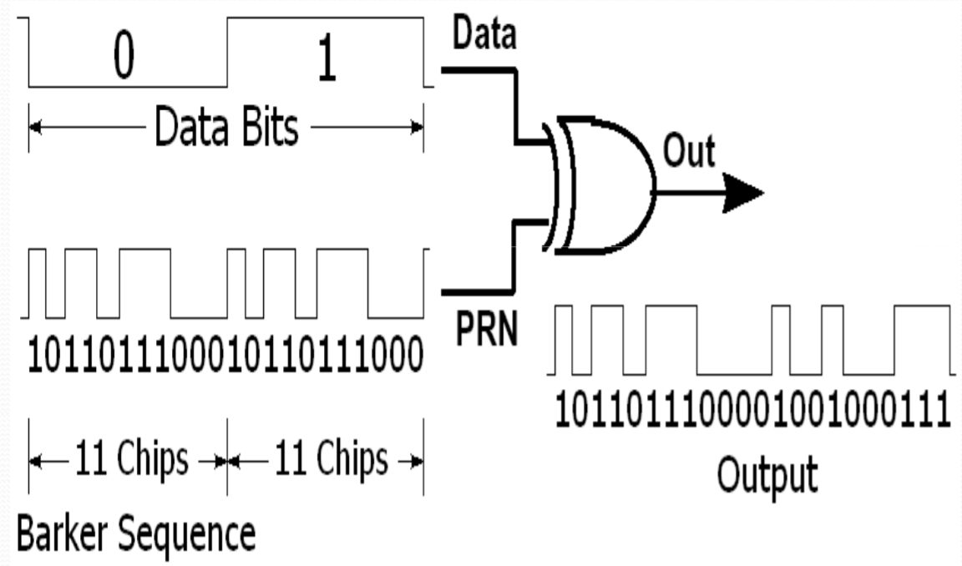
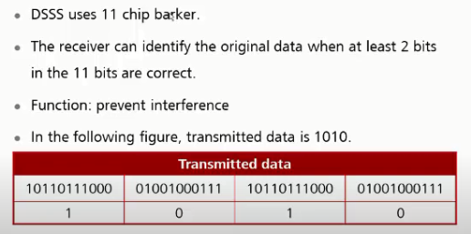
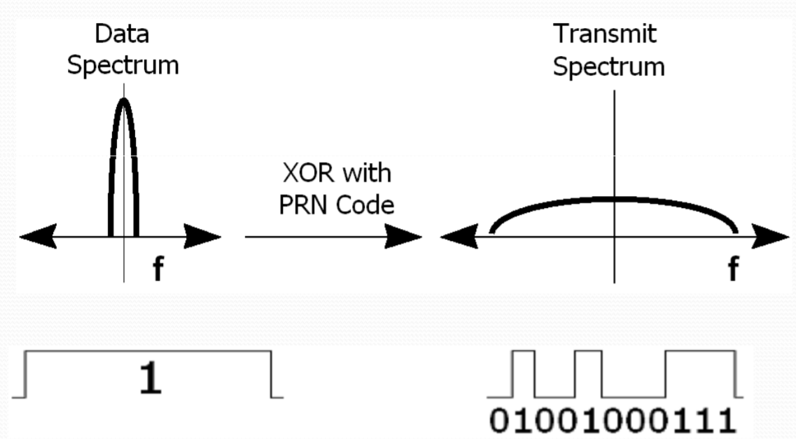
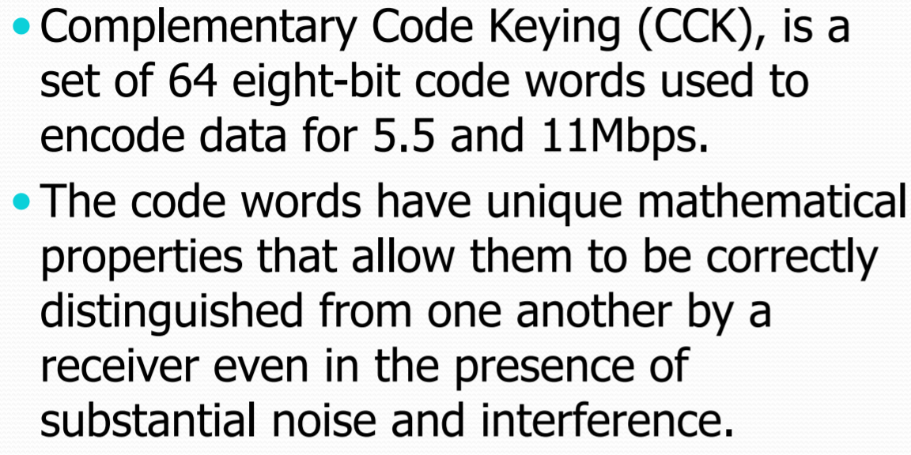
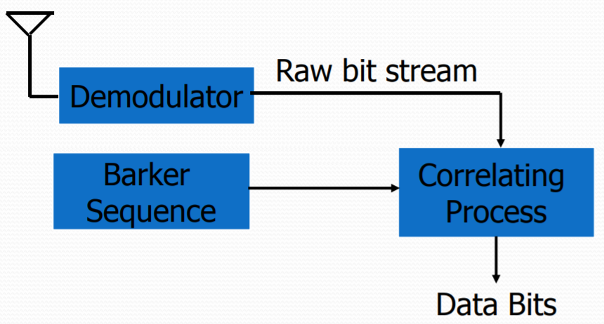
DSSS Coding and Modulation Cont’d
Transmit spread spectrum
Complementary Code keying (CCK)
Rx De-spreading

Slide 13
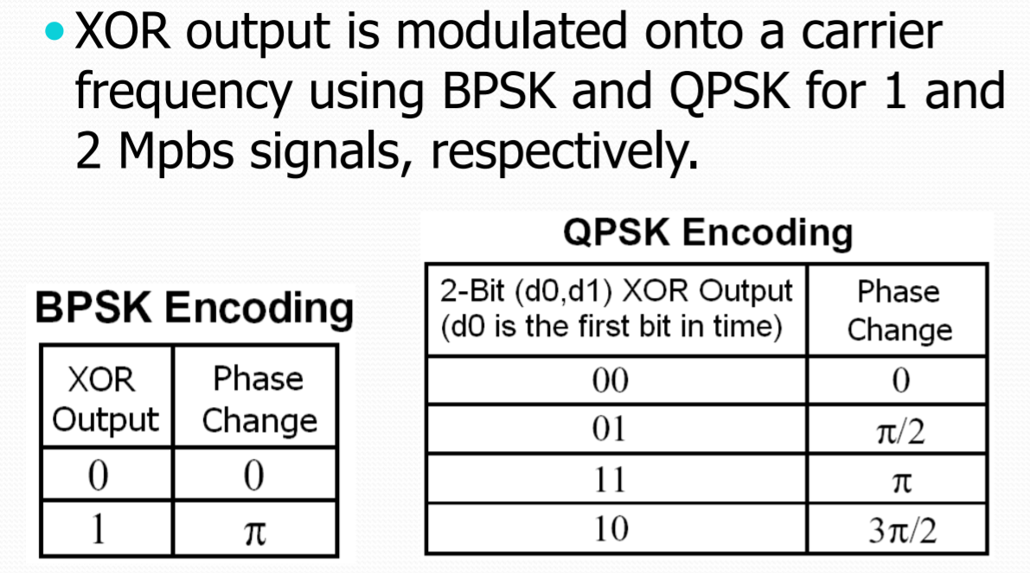
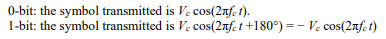
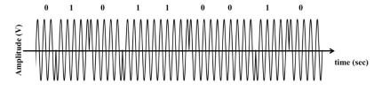
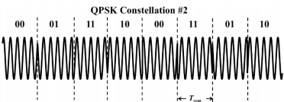
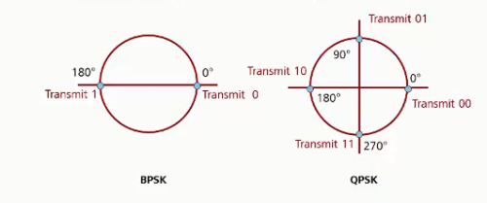
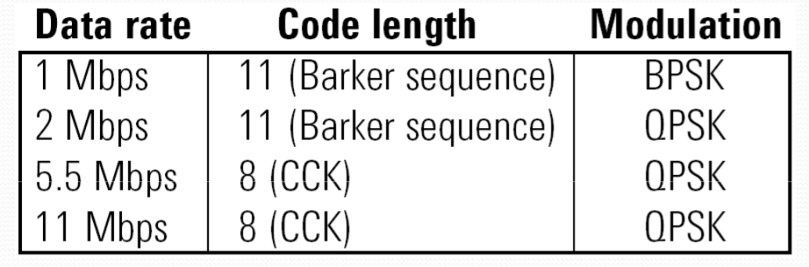
BPSK,QPSK Modulation schemes
BPSK
QPSK
Constellation for BPSK,QPSK

Slide 14
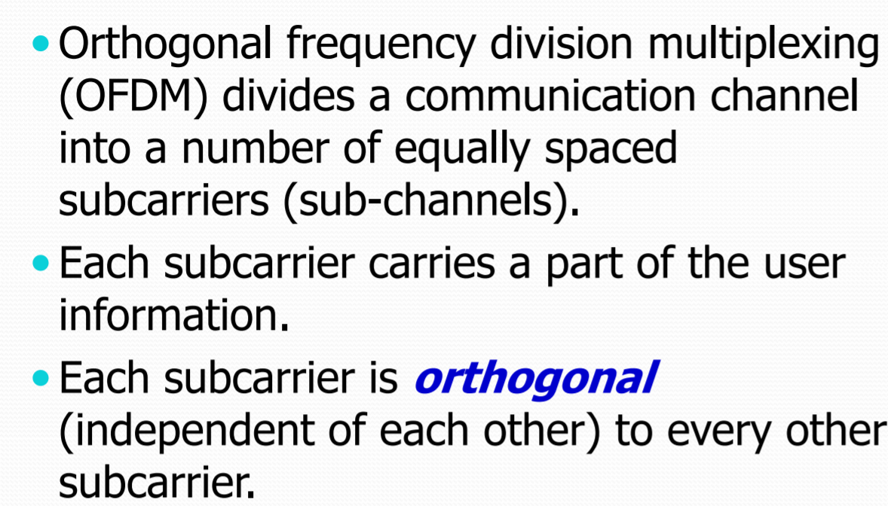
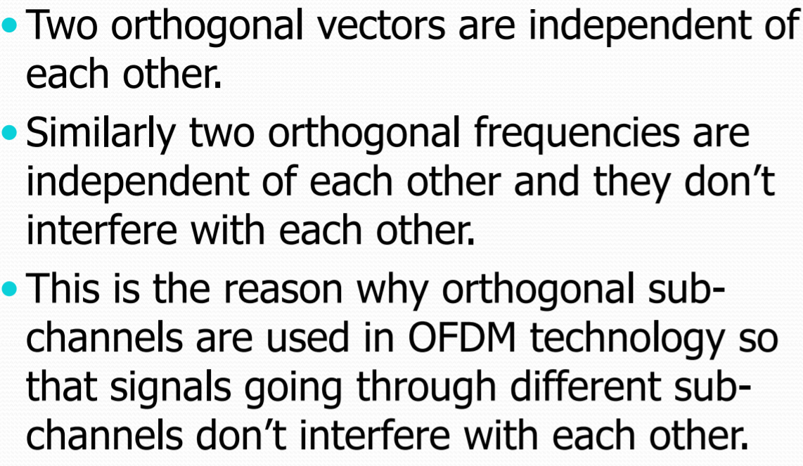
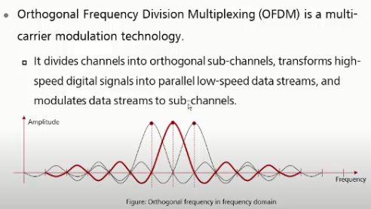
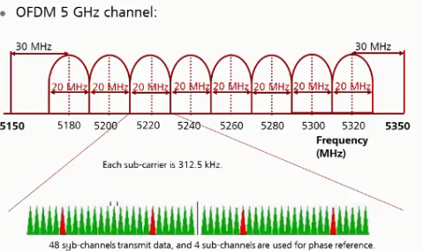
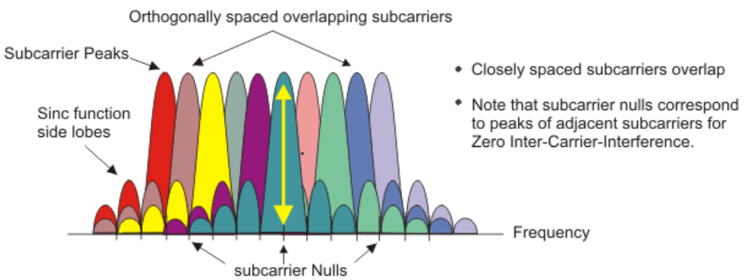
OFDM Multicarrier Scheme
Orthogonal sub carriers
5 GHz Channels
64 sub carriers 20MHz BW

Slide 15
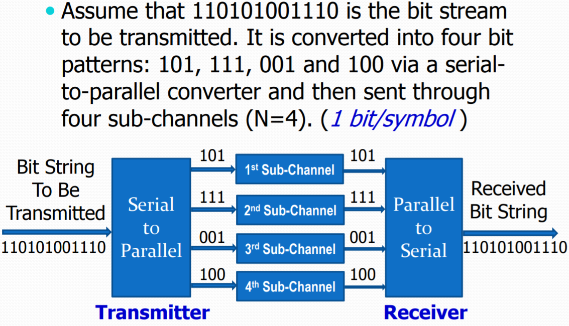
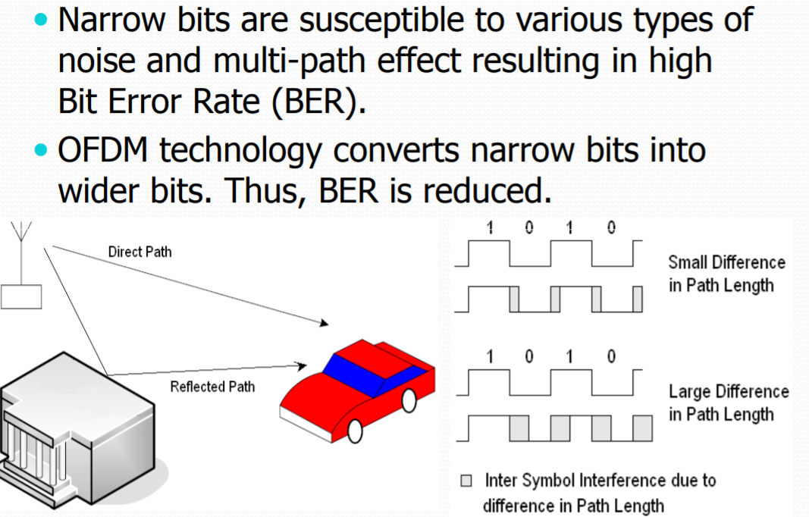
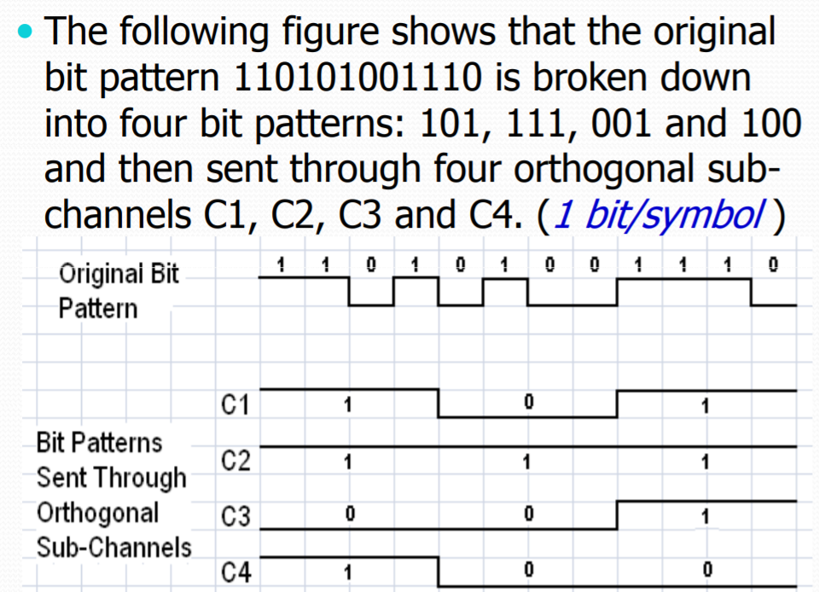
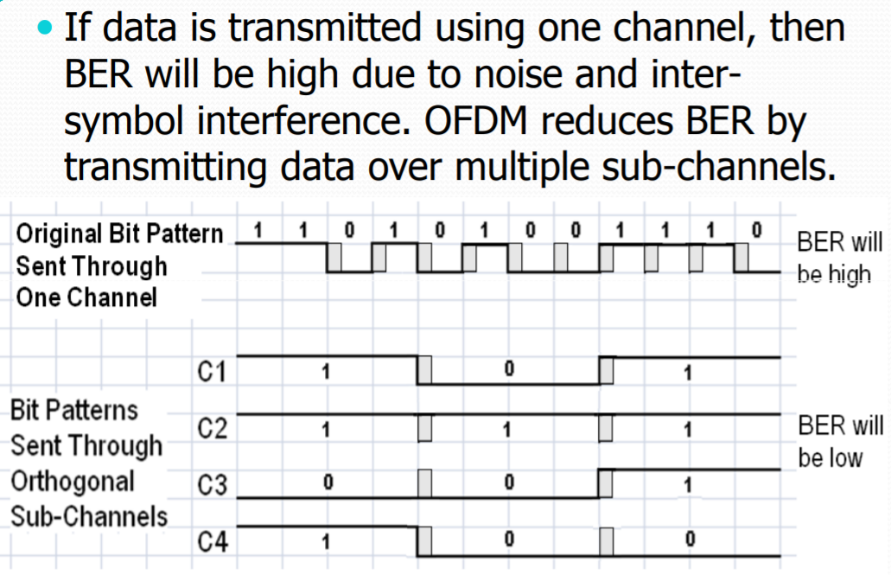
OFDM modulation format and advantages

Slide 16
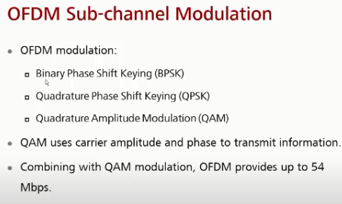
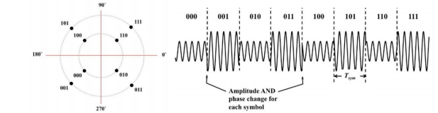
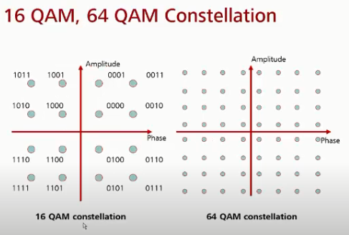
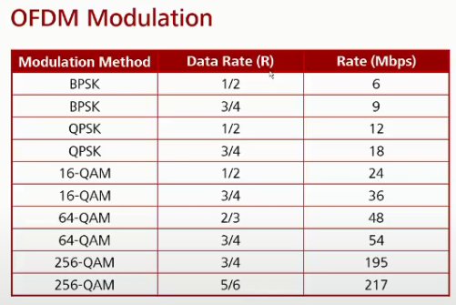
Quadrature Amplitude Modulation (QAM)
8 QAM
This system uses 4 possible phase angles and 2 possible amplitudes
Constellation shows 8 symbols along with 3 bits digital words
OFDM modulation & code rates

Slide 17
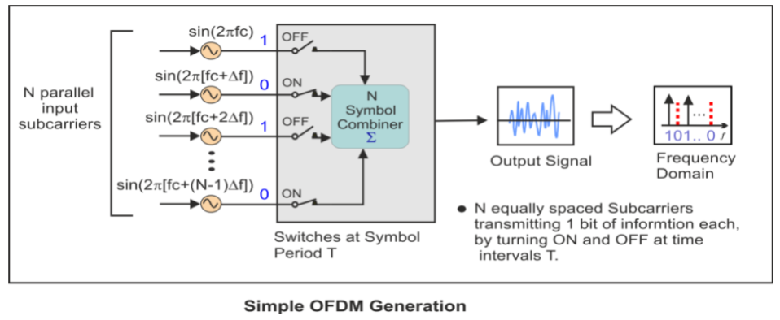
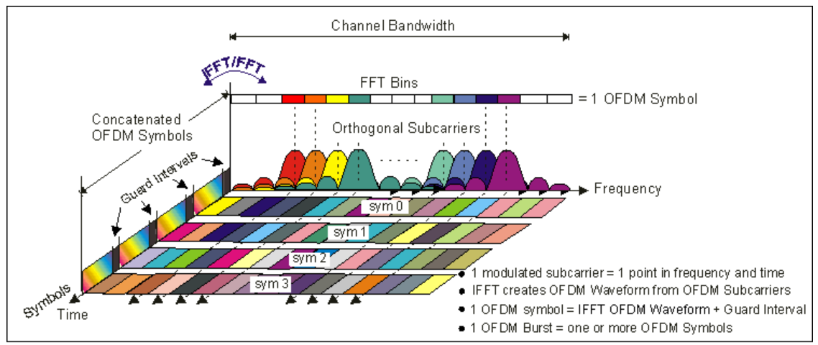
Later : OFDM Implementation

Slide 18
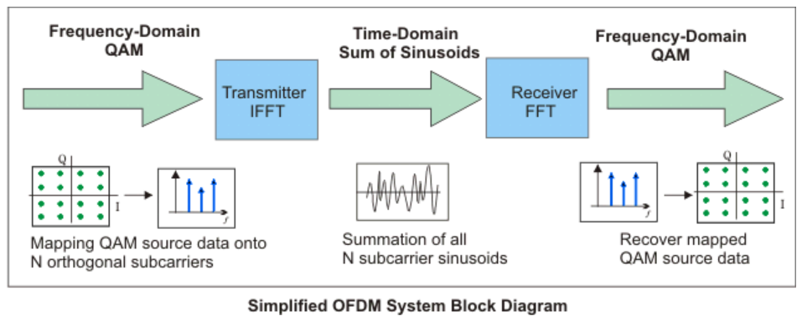
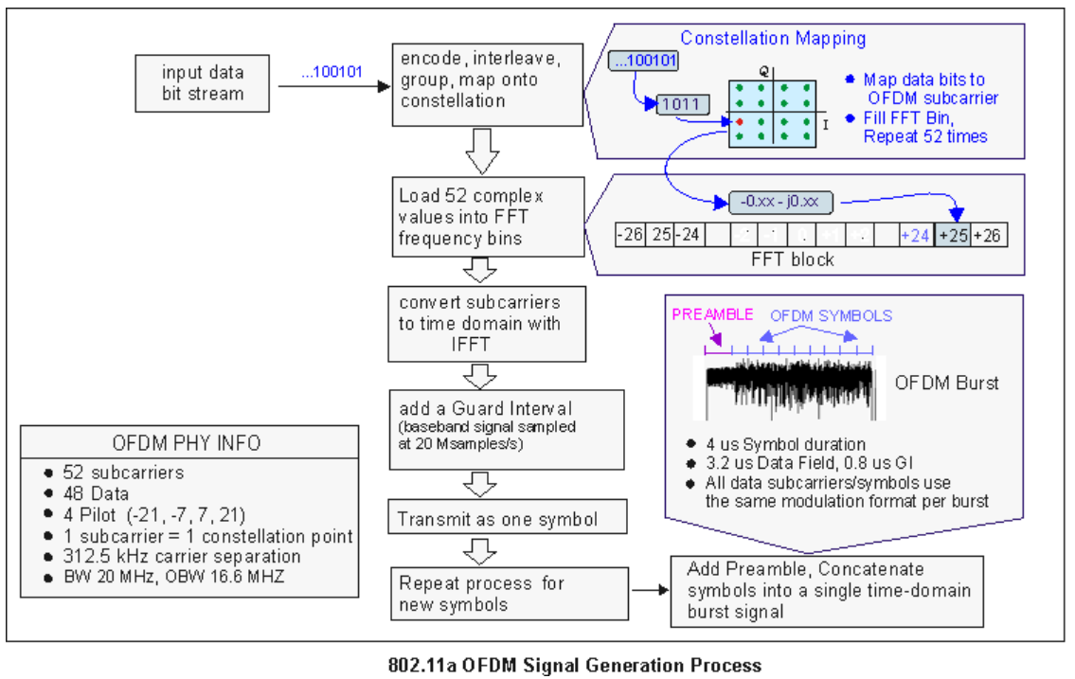
OFDM generation & Serial to parallel and Parallel to serial (IFFT/FFT) conversion

Slide 19
802.11N/AC specific details and comparison

